Slide 1
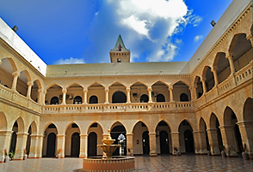

Dr. Sumbul Ansar

Slide 2
ISLAMIC STUDIES
LECTURE ONE

Slide 3
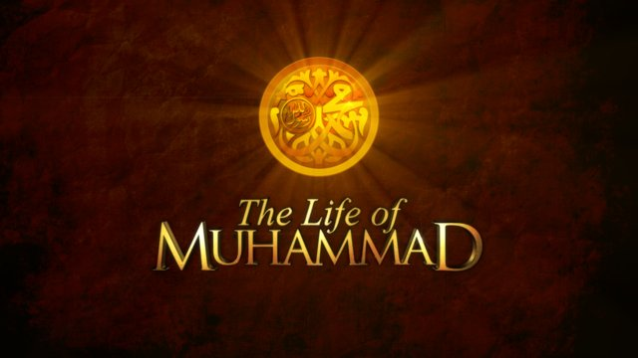
Seerat – un – Nabi (S.A.W.W)

Slide 4

INTRODUCTION:
In the distinguished family of Makah Hazrat Abdullah’s son Hazrat Muhammad (P.B.U.H) born after some time of the event of feil.
The difference between the birth of Hazrat Essa and Hazrat Muhammad (P.B.U.H) is 571 years.
Before the 2 months of his birth his father was died.
. He(P.B.U.H) was six years old when his mother went to the grand family of his father and on return his mother was died on the place of ”abwa”.
Hazrat Khadijah became captivated of Hazrat Muhammad (P.B.U.H) and send proposal of marriage to Hazrat Muhammad (P.B.U.H) after the matter of trade . At the time of marriage Hazrat Khadijah was widow and of 40 years old and Hazrat Muhammad (P.B.U.H) was only of 25 years old

Slide 5
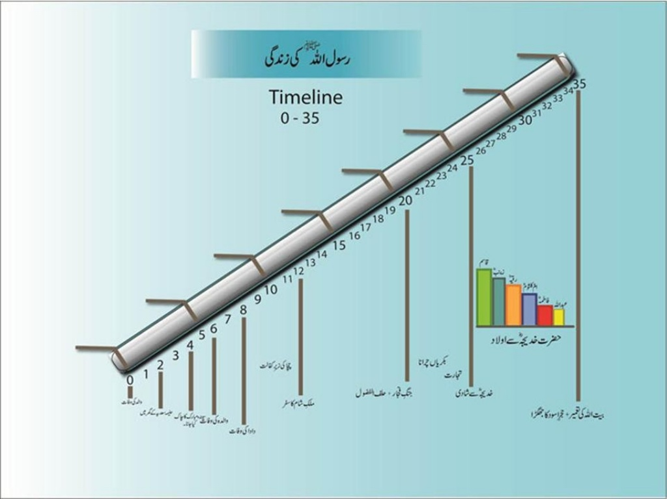
Introduction Of Prophet (SAWW) life

Slide 6

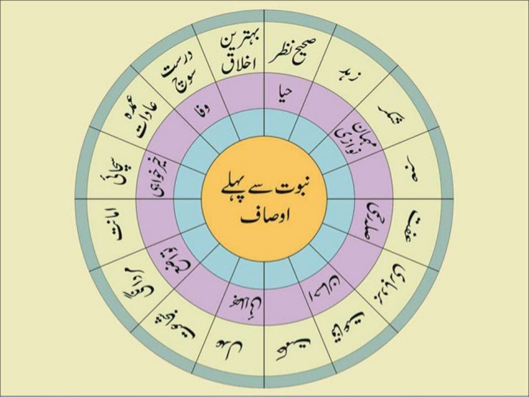
Before the Advent of Islam

Slide 7
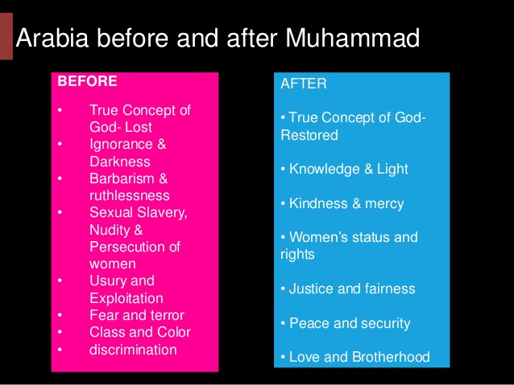
After and Before Advent of Islam

Slide 8

Revelation Of Wahi
The Prophet at the age of forty:
By the time the Holy Prophet of Islam reached the age of 40, he was ready for his divine mission. One day suddenly, while he sat in a cave at Mount Hira, Gabriel, the Angel of Revelation, appeared to him and said, `Recite!' He said in surprise, `What shall I recite?' Again the divine voice very clearly and openly called out, `Recite, O Muhammad!'
And a third time Gabriel repeated, "Recite in the Name of Your Lord Who created. He created the human being from a clot. Recite and your Lord is Most Honorable, Who taught (to write) with the pen, taught the human being what he knew not..." Holy Quran (Alaq 96: 1-5)

Slide 9

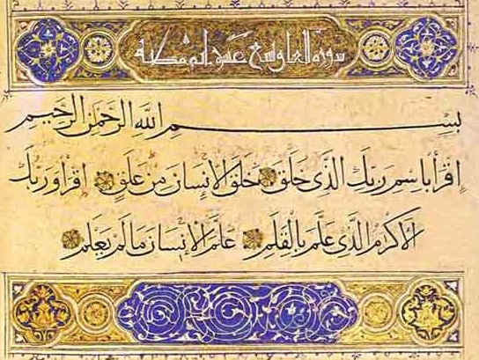
FIRST REVELATION:

Slide 10
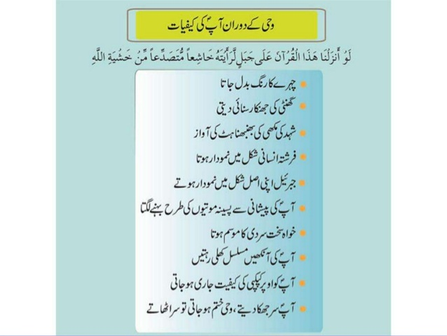
Situation of Prophet at the time of Revelation

Slide 11

AFTER THE REVELATION:
Perplexed by this new experience, Muhammad made his way to home where he was consoled by his wife Khadijah, who also took him to her Ebonite cousin Waraqah ibn Nawfal. Waraqah was familiar with Jewish and Christian scriptures. Islamic tradition holds that Waraqah, upon hearing the description, testified to Muhammad's Prophethood, and convinced Muhammad that the revelation was from God. Waraqah said: "O my nephew! What did you see?" When Muhammad told him what had happened to him, Waraqah replied: "This is Namus (meaning Gabriel) that Allah sent to Moses. I wish I were younger. I wish I could live up to the time when your people would turn you out." Muhammad asked: "Will they drive me out?" Waraqah answered in the affirmative and said: "Anyone who came with something similar to what you have brought was treated with hostility; and if I should be alive until that day, then I would support you strongly." A few days later Waraqah died.

Slide 12

Politeness with Children:
Children used to sit in the company of Prophet (SAWW) where Abu Bakkr and Hazrat Umar used to sit.
A bowl of milk was given to Prophet and He drank some sips from their in that company on his right side a young boy child was sitting and the left side Abu Bakkr and Umar the great and senior companion were sitting.
Holy Prophet (SAWW) Sunnah was after having some sip He used to handover the bowl who was sitting at the first on His right side and He never started from the left side, this was the tayamun.
So according to Sunnah He wanted to start to give this left over to the people sitting on right side but by chance on right side a little boy was sitting and on left side the senior companion were sitting.
He wished to give His left over to senior companion but His practice was to give on the right side first so, Holy Prophet asked that boy:
“Oh ! My son, Do you allow Me that I may give this left over first
to those who are the senior sitting on my left side. Do you allow me.?

Slide 13
That boy said,
“Not allowed because you have drunk from this bowl
and your lips touched this bowl and can’t sacrifice to touch my
lips state away of the touching of your lips.”
So He refused and Holy Prophet(SAWW) had to give that bowl to the small boy.
He used to train the kids and young boys sitting in His company.

Slide 14

Rights To Neighbors.
The neighbor holds a special status in Islam. Islam encourages Muslims to treat their neighbors in a gentle way that reflects the true and genuine spirit of Islam as exemplified in its tolerant aspect especially with people of other faiths. It makes no difference whether the neighbors are Muslim or non-Muslim. Ayesha, the Mother of the Believers, stated that she once asked Prophet Muhammad (peace and blessings be upon him), "O Messenger of Allah! I have two neighbors. To whom shall I send my gifts?" Prophet Muhammad (peace and blessings be upon him) said, "To the one whose gate is nearer to you.“
Being good to neighbors is not only restricted to those who share the same building with you. Your roommate at the dorm is your neighbor; the person sitting behind you or next to you in a bus or at a bus stop is your neighbor; the one sharing your office at work is your neighbor; the person enjoying fresh air next to you in a public garden is also a neighbor. You ought to treat all of those people kindly and socialize with them within the permitted scope of Shariah Islamic Law.

Slide 15
Attitude with Non – Muslims.
The Prophet showed endless patience while conveying the message of Islam to the non-Muslims. He never tired of speaking to people and sharing with them the monotheistic belief which is the essence of the religion. He was always sincere in his relationships and he abstained from useless polemics or quarrels. As is stated in the Holy Qur'an, the Prophet always treated people well; he used kind words and avoided rude and aggressive behavior. As a matter of fact, despite the rude behavior of some of the communities he encountered while spreading the religion, the Prophet curbed his anger and asked Allah for salvation for them. For instance, when Prophet Muhammad went to Taa'if with Zayd ibn Haritha in search of a freer environment in which to convey the message of Islam due to the increasing pressure in Mecca, the leading figures in Taa'if treated him rudely and ordered the people to stone him and drive him out of the city. In response to this sad experience, Prophet Muhammad prayed that the people of Ta'if would be granted deliverance. It was due to his kind and forgiving attitude that the people did not refuse to listen to his message; rather, they considered it and decided to accept Islam, despite their initial opposition.

Slide 16
Prophet Muhammad focused on the humanity of the people he addressed, rather than on their differences in faith, ideas and lifestyles. In other words, he behaved in line with the idea that the people around him were human and possessed a life and soul. He did not base his actions on whether they were Muslim or not. For instance, in Medina the Prophet stood up before a passing funeral procession. His companions said to him: “O Prophet, that man was not a Muslim.” In response to this, the Prophet emphasized the quality of being human, a common feature that all people share, with the following words: “Did he not have a soul?”
The Prophet guaranteed the lives, property, honor and freedom of religion of the non-Muslims who lived among the Muslims, and he put a great emphasis on these issues. Islam gives great importance to the protection of basic values in the religion.

Slide 17
Prophet(SAWW) gave the women her Rights:
Throughout the human history prior to Islam, women have been victimized and made to suffer too much. They endured unbearable deprivation, sorrow and oppression in all past civilizations. In other words, they were treated as if they were not human beings.
The Greeks said regarding a woman: She is like a poisonous tree and she is evil emanated from Satan. She may be sold like any merchandise.
For the Romans: She does not have a soul. They would torture women by pouring boiling oil on them or dragging them by horses.
For the Chinese: She is cursed water that washes away good fortune. A Chinese man would have the right to bury his wife alive. If a man were to die, his wife would be passed on as inheritance.

Slide 18
For the Indians: A woman is worse than death, hell, and fire. A woman didn’t have the right to live after her death. Therefore, she had to be burned along with his corpse.
For the Persians: It is permissible to marry any of the female relatives without exception (incest). A Persian husband could command his wife to die.
The Jews said: A woman is a curse because she is the cause of sin and temptation. She is impure during her menses. It is permissible for her father to sell her.
The Christians: The French held a discussion in 568 A.D. Some of the issues discussed were: Is a woman a human or not? Does she have soul or not? If she has a soul, is it a human soul or an animal soul? And if it is a human soul then is it equal to a man’s soul lower than it? Finally, after long deliberation, they came to the conclusion that she is human, but she was created only to serve man.

Slide 19
As for the Arabs before Islam: They hated women more than death. They used to burry female infants alive or threw them into an abandoned well.
Islam: The True Liberator of women
After this long history of injustice, Allah, the Most Exalted showered His Mercy on humanity by a Religion (Islam) the teaching of which came to change the ugly human history and to create a life which humanity had never witnessed before in all its civilizations.
Women in the Quran:
The Noble Quran, Muslims' Infallible Book revealed by Almighty Allah, is replete with verses speaking about women, which indicates the honorable status Islam holds for them. There is a full Soorah (Chapter) named: "Women". This Chapter is among the longest ones in the Quran. Hereunder are some of such verses (which mean):
{…And due to the wives is similar to what is expected of them, according to what is reasonable.} [Quran 2:228]
{…And live with them in kindness.} [Quran 4:19]

Slide 20

The Ending Words:
Hazrat Muhammad S.A.W.W ALLAH Kareem kay akhri Nabi hain jnki rehmat tmaam insaano kay lye taaqayamat tk rhay ge. ALLAH kay tmaam Ambiyaa nay apni qaumon ko Nabi S.A.W.W kay aanay ki khushkhabri di kay Nabi S.A.W.W tmaam Ambiyaa kay sardaar hain. ALLAH Kareem ny Quran mai bayan farmaya kay “Aap S.A.W.W ko tmaam jahanon kay lye rehmat bnna kr bheja gyaa hai”. Nabi S.A.W.W ki hayaat e Tayyaba par beshumaar likha gyaa hai, lekin ALLAH nay apko wo makkam bhakhsha hai kay kici insaan ki itni istataat nahe kay apki khoobiyaan aur seerat bayan kr skay.

